Slide 1

Vivekanand Education Society’s Institute Of Technology
Department Of Information Technology
DSA mini Project
A.Y. 2025-26
Sustainability Goal :
Title: MOVIE BOOKING SYSTEM
Domain: DSA
Member: MANAV JETHANI
Mentor Name:KAJAL JEWANI

Slide 2


Slide 3
Content
Introduction to the Project
Problem Statement
Objectives of the Project
Requirements of the System (Hardware, Software)
Time and Space Complexity
Front End Implementation
Back End Implementation
Gantt Chart
10. Future Scope
11. Output Screenshots
12. Conclusion
13. References (in IEEE Format)

Slide 4
Introduction to Project
A system to book movie tickets digitally.
Simulates real-life ticket booking process in a console application.
Uses C language, 2D arrays, and queue for audience and booking management.
Helps in managing multiple bookings efficiently.
r Rates

Slide 5
Problem Statement
Manual ticket booking is time-consuming.
Managing audience names, seats, and show timings manually is error-prone.
Need for an automated system to handle bookings, show details, and payments.
r Rates

Slide 6
Objectives of the project
rTo create a console-based movie ticket booking system.
To manage audience names using 2D arrays.
To implement queue for processing bookings in order.
To display booking details in a structured and decorated format.
To calculate total amount automatically.
Rates

Slide 7
Requirements of the system (Hardware, software)
Software:
C compiler (Turbo C, GCC, Code::Blocks, Dev C++).
Hardware:
Minimum 2GB RAM, 1GB free storage.
Functional:
Book tickets, display audience list, show timings, process queue.
Non-functional:
Fast, simple, easy-to-use console interface.
lem Statement

Slide 8
TIME AND SPACE COMPLEXITY
Time Complexity:
Input names → O(n)
Display audience → O(n)
Queue operations → O(1) (enqueue/dequeue)
Space Complexity:
2D array for names → O(n*m)
Queue array → O(MAX)

Slide 9
Front End Implementation
Console-based user interface using printf and scanf.
Decorative output using lines, stars, and emojis.
Column-wise display of movie list and audience names.
Input validations for movie ID, audience count, and show time.

Slide 10
Back end Implementation
Queue to manage bookings (FIFO).
2D Array for storing audience names.
Calculation of total amount automatically.
Booking ID generation.
Processing bookings using enqueue() and dequeue() functions.

Slide 11
Gantt Chart
Task | Description | Week 1 | Week 2 | Week 3 | Week 4 | Week 5
1. Problem Analysis | Identify the problem, objectives & scope | ██████
2. Requirement Gathering | Define functional & non-functional requirements | ██████ | ██████
3. System Design (ER + Flowchart) | Design ER diagram, algorithm & layout |  | ██████ | ██████
4. Frontend Implementation | Build user interface using printf/scanf |  |  | ██████
5. Backend Implementation | Implement Queue, 2D Array & logic in C |  |  | ██████ | ██████
6. Integration & Testing | Combine frontend & backend, test cases |  |  |  | ██████
7. Documentation & Report | Prepare PPT, report, and conclusion |  |  |  |  | ██████
Notes:
The max flow algorithm in the visualization is :-

Slide 12
FUTURE SCOPE
Extend to seat selection using 2D seat layout.
Add GUI for better user interaction.
Connect to database for storing past bookings.
Add online payment integration.
Implement mobile app or web version.

Slide 13
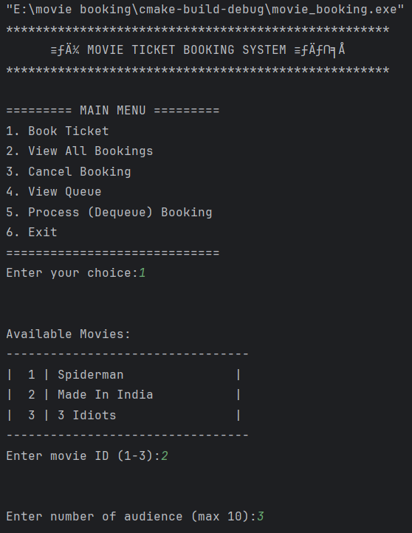
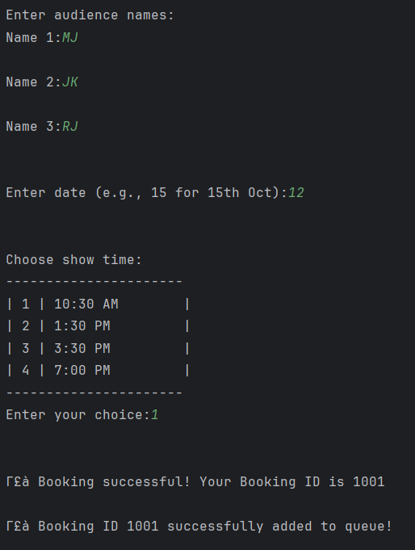
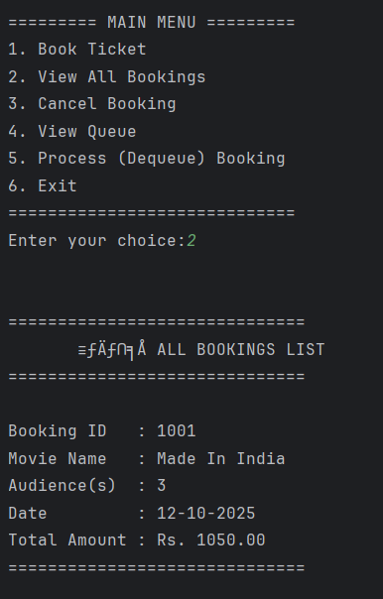
OUTPUT

Slide 14
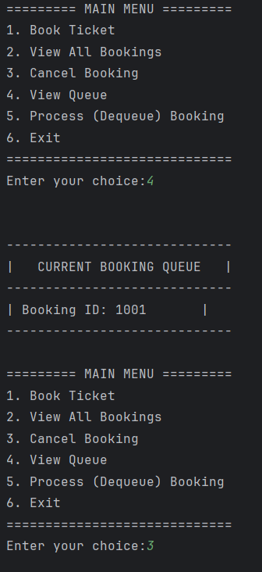
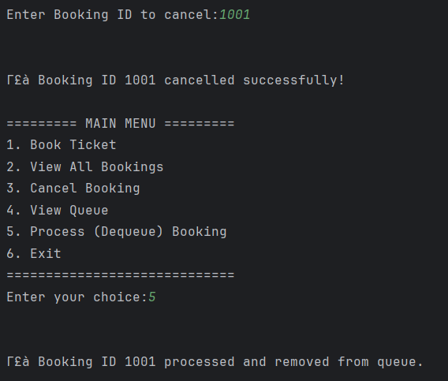
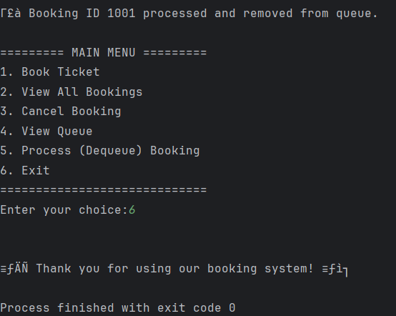
OUTPUT

Slide 15
Conclusion
Successfully created a console-based movie ticket booking system.
Demonstrated frontend (user interaction) and backend (logic & queue).
Handles audience names, booking IDs, total amount, and queue efficiently.
Can be enhanced for real-world applications.

Slide 16
References
“Programming in C” – E. Balagurusamy
GeeksforGeeks – Queue and 2D Arrays in C
TutorialsPoint – File handling & Console Output in C
GitHub – Sample C Projects for beginners

